Slide 1
Anterior and posterior thigh musculature.

Slide 2
The musculature of the thigh can be split into three sections; anterior, medial and posterior. Each compartment has a distinct innervation and function.
The muscles in the anterior compartment of the thigh are innervated by the femoral nerve (L2-L4), and as a general rule, act to extend the leg at the knee joint.
There are three major muscles in the anterior thigh – the pectineus, sartorius and quadriceps femoris.
In addition to these, the end of the iliopsoas muscle passes into the anterior compartment

Slide 3
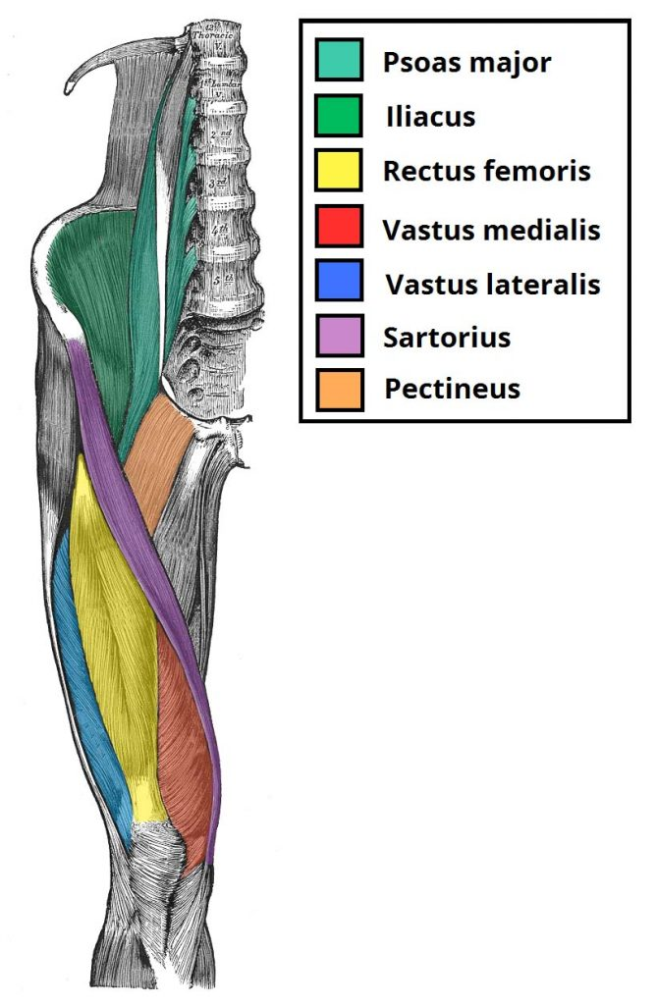

Slide 4
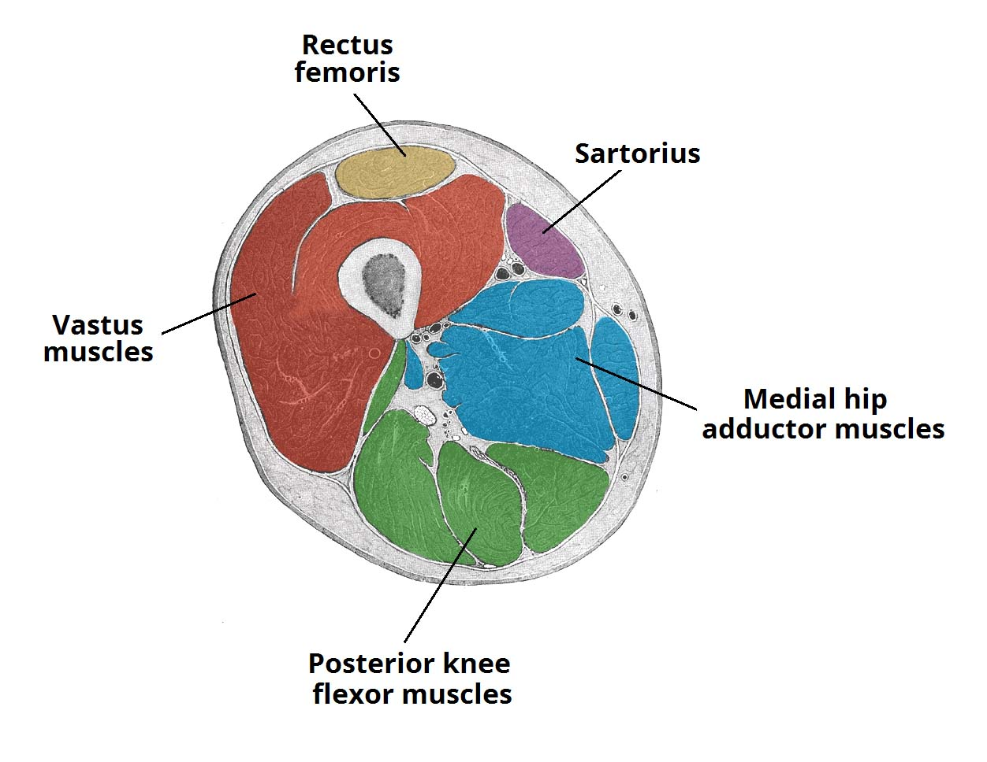

Slide 5
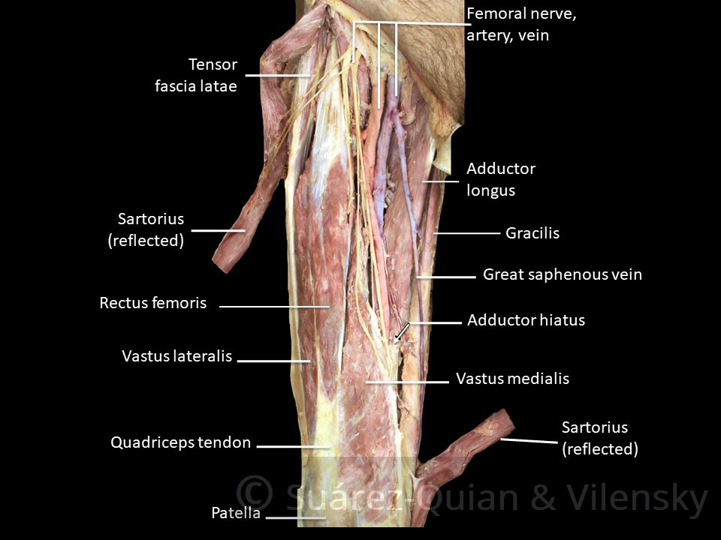

Slide 6
ILIO PSOAS
The iliopsoas is actually two muscles, the psoas major and the iliacus. They originate in different areas, but come together to form a tendon, hence why they are commonly referred to as one muscle.
Unlike many of the anterior thigh muscles, the iliopsoas does not extend the leg at the knee joint.
Attachments: The psoas major originates from the twelfth thoracic﻿ and all five lumbar vertebrae﻿ and the iliacus originates from the iliac fossa of the pelvis. They insert together onto the lesser trochanter of the femur.
Actions: Flexes the thigh at the hip joint.
Innervation: The psoas major is innervated by anterior rami of L1-3, while the iliacus is innervated by the femoral nerve.

Slide 7
The quadriceps femoris
The quadriceps femoris consists of four individual muscles; three vastus muscles and the rectus femoris. They form the main bulk of the thigh, and collectively are one of the most powerful muscles in the body.
The muscles that form the quadriceps femoris unite proximal to the knee and attach to the patella via the quadriceps tendon. In turn, the patella is attached to the tibia by the patella ligament. The quadriceps femoris is the main extensor of the knee.

Slide 8
Vastus Lateralis
Proximal attachment: Originates from the greater trochanter and the lateral lip of linea aspera.
Actions: Extends the knee joint and stabilises the patella.
Innervation: Femoral nerve.

Slide 9
Vastus Intermedius
Proximal attachment: Anterior and lateral surfaces of the femoral shaft.
Actions: Extends the knee joint and stabilises the patella.
Innervation: Femoral nerve.

Slide 10
Vastus Medialis
Proximal attachment: The intertrochanteric line and medial lip of the linea aspera.
Actions: Extends the knee joint and stabilises the patella, particularly due to its horizontal fibres at the distal end.
Innervation: Femoral nerve.

Slide 11
Rectus Femoris
Attachments: Originates from the anterior inferior iliac spine and the area of the ilium immediately superior to the acetabulum. It runs straight down the leg and attaches to the patella via the quadriceps femoris tendon.
Actions: The only muscle of the quadriceps to cross both the hip and knee joints. It flexes the thigh at the hip joint, and extends at the knee joint.
Innervation: Femoral nerve.

Slide 12
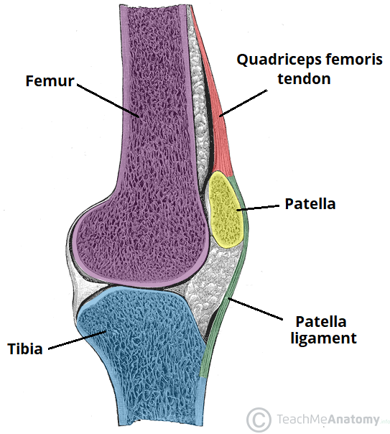

Slide 13
The sartorius
The sartorius is the longest muscle in the body. It is long and thin, running across the thigh in a inferomedial direction. The sartorius is positioned more superficially than the other muscles in the leg.
Attachments: Originates from the anterior superior iliac spine, and attaches to the superior, medial surface of the tibia.
Actions: At the hip joint, it is a flexor, abductor and lateral rotator. At the knee joint, it is also a flexor.
Innervation: Femoral nerve.

Slide 14
The pectineus muscle
The pectineus muscle is a flat muscle that forms the base of the femoral triangle. It has a dual innervation, and thus can be considered a transitional muscle between the anterior thigh and medial thigh compartments.
Attachments: It originates from the pectineal line on the anterior surface of the pelvis, and attaches to the pectineal line on the posterior side of the femur, just inferior to the lesser trochanter.
Actions: Adduction and flexion at the hip joint.
Innervation: Femoral nerve. May also receive a branch from the obturator nerve.

Slide 15
MEDIAL THIGH
The muscles in the medial compartment of the thigh are collectively known as the hip adductors. There are five muscles in this group; gracilis, obturator externus, adductor brevis, adductor longus and adductor magnus.
All the medial thigh muscles are innervated by the obturator nerve, which arises from the lumbar plexus. Arterial supply is via the obturator artery.

Slide 16
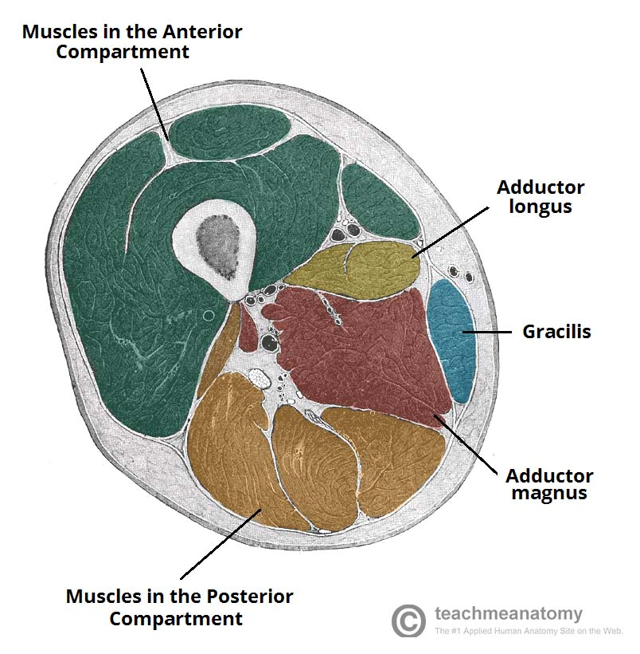

Slide 17
OBTURATOR NERVE
The obturator nerve is formed from the lumbar plexus. It receives fibres from the anterior divisions of L2, L3 and L4.
After its formation, the obturator nerve descends through the fibres of the psoas major and emerges from its medial border. It then travels posteriorly to the common iliac arteries and laterally along the pelvic wall – towards the obturator foramen of the pelvis.
The obturator nerve enters the medial thigh via the obturator canal (formed within the obturator foramen by the obturator membrane). It then divides into anterior and posterior branches:

Slide 18
Anterior division:
Descends between the adductor longus and adductor brevis (towards the femoral artery).
Here, it supplies motor fibres to the adductor longus, adductor brevis and gracilis. In rare cases, it can also supply the pectineus muscle.
It then pierces the fascia lata to become the cutaneous branch of the obturator nerve.
Posterior division:
Passes through the obturator externus muscle and then travels anteriorly to reach the adductor magnus.
Innervates the obturator externus and adductor magnus muscles.

Slide 19
Adductor Magnus
The adductor magnus is the largest muscle in the medial compartment. It lies posteriorly to the other muscles.
Functionally, the muscle can be divided into two parts; the adductor part, and the hamstring part.
Attachments
Adductor part – Originates from the inferior rami of the pubis and the rami of ischium, attaching to the linea aspera of the femur.
Hamstring part – Originates from the ischial tuberosity and attaches to the adductor tubercle and medial supracondylar line of the femur.
Actions: They both adduct the thigh. The adductor component also flexes the thigh, with the hamstring portion extending the thigh.
Innervation: Adductor part is innervated by the obturator nerve (L2-L4), the hamstring part is innervated by the tibial component of the sciatic nerve (L4-S3).

Slide 20
Adductor Longus
The adductor longus is a large, flat muscle. It partially covers the adductor brevis and magnus. The muscle forms the medial border of the femoral triangle.
Attachments: Originates from the pubis, and expands into a fan shape, attaching broadly to the linea aspera of the femur
Actions: Adduction of the thigh.
Innervation: Obturator nerve (L2-L4).

Slide 21
Adductor Brevis
The adductor brevis is a short muscle, lying underneath the adductor longus.
It lies in between the anterior and posterior divisions of the obturator nerve. Therefore, it can be used as an anatomical landmark to identify the aforementioned branches.
Attachments: Originates from the body of pubis and inferior pubic rami. It attaches to the linea aspera on the posterior surface of the femur, proximal to the adductor longus.
Actions: Adduction of the thigh.
Innervation: Obturator nerve (L2-L4).

Slide 22
Obturator Externus
This is one of the smaller muscles of the medial thigh, and it is located most superiorly.
Attachments: It originates from the membrane of the obturator foramen, and adjacent bone. It passes under the neck of femur, attaching to the posterior aspect of the greater trochanter.
Actions: Adduction and lateral rotation of the thigh.
Innervation: Obturator nerve (L2-L4).

Slide 23
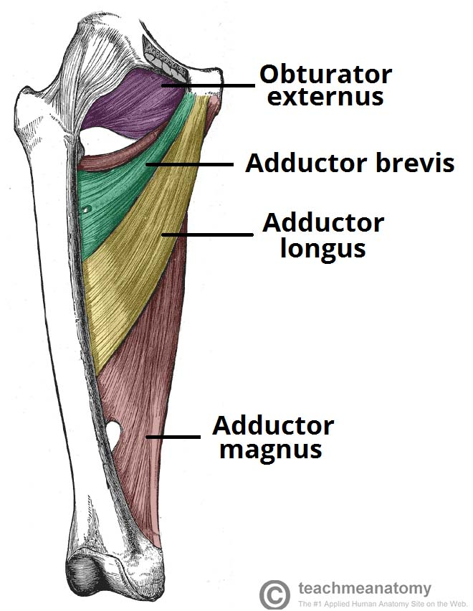

Slide 24
GRACILIS
The gracilis is the most superficial and medial of the muscles in this compartment. It crosses at both the hip and knee joints. It is sometimes transplanted into the hand or forearm to replace a damaged muscle.
Attachments: It originates from the inferior rami of the pubis, and the body of the pubis. Descending almost vertically down the leg, it attaches to the medial surface of the tibia, between the tendons of the sartorius (anteriorly) and the semitendinosus (posteriorly).
Actions: Adduction of the thigh at the hip, and flexion of the leg at the knee.
Innervation: Obturator nerve (L2-L4).

Slide 25
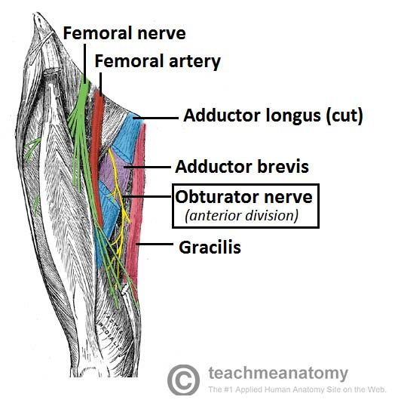

Slide 26
POSTERIOR THIGH
The muscles in the posterior compartment of the thigh are collectively known as the hamstrings. They consist of the biceps femoris, semitendinosus and semimembranosus, which form prominent tendons medially and laterally at the back of the knee.
As group, these muscles act to extend at the hip, and flex at the knee. They are innervated by the sciatic nerve (L4-S3).

Slide 27
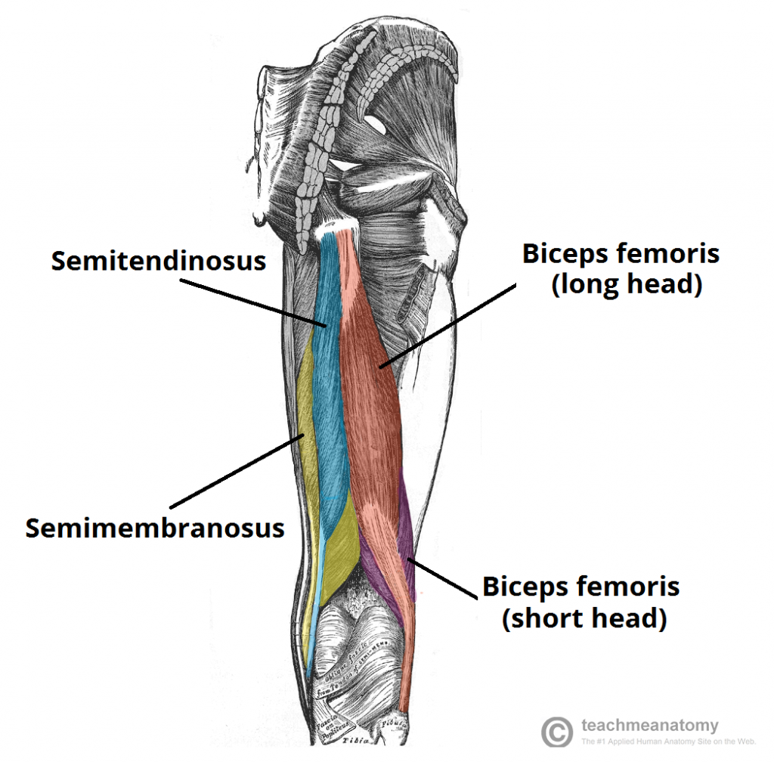

Slide 28
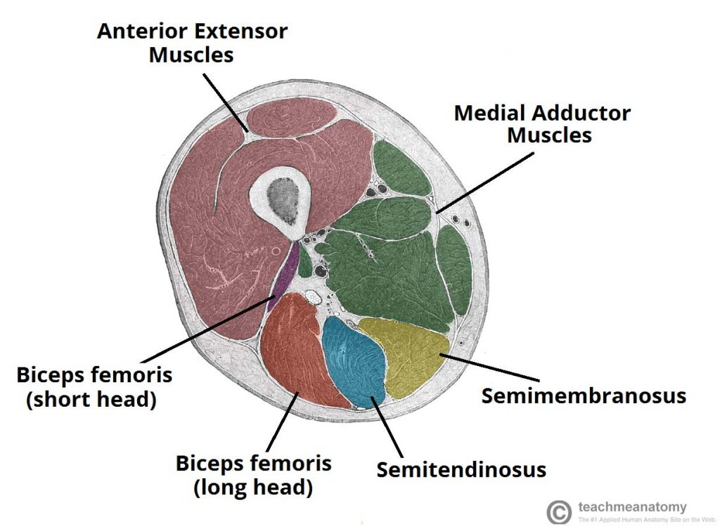

Slide 29
The muscles located within the posterior compartment of the thigh are the biceps femoris, semitendinosus and semimembranosus.
Note: The hamstring portion of the adductor magnus has a similar action to these muscles, but is located in the medial thigh.

Slide 30
Biceps Femoris
Like the biceps brachii in the arm, the biceps femoris muscle has two heads – a long head and a short head.
It is the most lateral of the muscles in the posterior thigh – the common tendon of the two heads can be felt laterally at the posterior knee.
Attachments: The long head originates from the ischial tuberosity of the pelvis. The short head originates from the linea aspera on posterior surface of the femur. Together, the heads form a tendon, which inserts into the head of the fibula.
Actions: Main action is flexion at the knee. It also extends the thigh at the hip, and laterally rotates at the hip and knee.
Innervation: Long head innervated by the tibial part of the sciatic nerve, whereas the short head is innervated by the common fibular part of the sciatic nerve.

Slide 31
SCIATIC NERVE
The sciatic nerve is a major nerve of the lower limb. It is a thick flat band, approximately 2cm wide – the largest nerve in the body.
Nerve roots: L4-S3.
Motor functions:
Innervates the muscles of the posterior thigh (biceps femoris, semimembranosus and semitendinosus) and the hamstring portion of the adductor magnus (remaining portion of which is supplied by the obturator nerve).
Indirectly innervates (via its terminal branches) all the muscles of the leg and foot.
Sensory functions: No direct sensory functions. Indirectly innervates (via its terminal branches) the skin of the lateral leg, heel, and both the dorsal and plantar surfaces of the foot.

Slide 32
Semitendinosus
The semitendinosus is a largely tendinous muscle. It lies medially to the biceps femoris, and covers the majority of the semimembranosus.
Attachments: It originates from the ischial tuberosity of the pelvis, and attaches to the medial surface of the tibia.
Actions: Flexion of the leg at the knee joint. Extension of thigh at the hip. Medially rotates the thigh at the hip joint and the leg at the knee joint.
Innervation: Tibial part of the sciatic nerve.

Slide 33
Semimembranosus
The semimembranosus muscle is flattened and broad. It is located underneath the semitendinosus.
Attachments: It originates from the ischial tuberosity, but does so more superiorly than the semitendinosus and biceps femoris. It attaches to the medial tibial condyle.
Actions: Flexion of the leg at the knee joint. Extension of thigh at the hip. Medially rotates the thigh at the hip joint and the leg at the knee joint.
Innervation: Tibial part of the sciatic nerve.

